Slide 1
Logistic regression

Slide 2
Learning overview
At the end of the session, you will be able to:
Explain the concept of classification in machine learning (ML)
Articulate the difference between linear and logistic regression
Understand logistic regression’s cost function
Understand gradient descent for optimization
Determine the appropriate metrics for evaluating classifiers
Implement a logistic regression model in scikit-learn

Slide 3
What is classification?

Slide 4
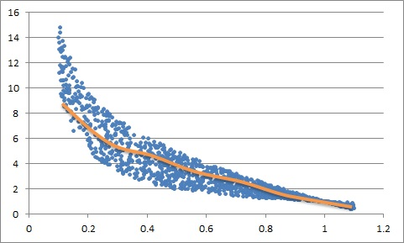
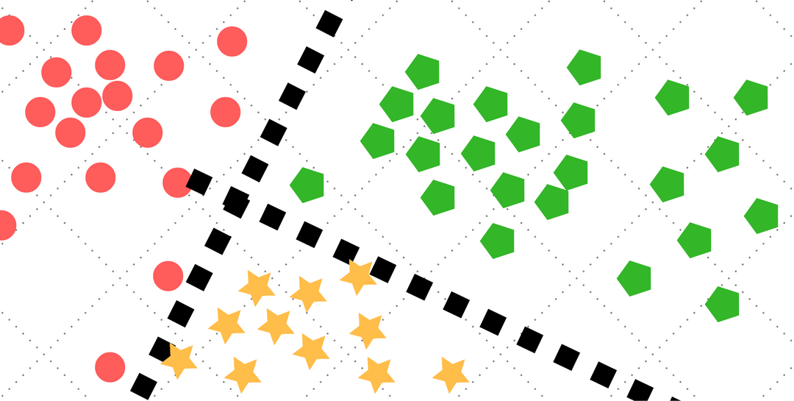
Supervised learning problems
Regression
Classification

Slide 5
Regression vs classification
Regression
Classification
Objective is to predict a numeric outcome:
Integer outcomes
Real outcomes
Objective is to prediction a categorical outcome:
Binary outcomes
Multi-class outcomes
Multi-label outcomes
Ordinal outcomes
Notes:
For ordinal outcomes, use the example of non-equal interval income buckets (e.g. [0, 2000), [2000, 5000), etc)

Slide 6
predict how many stars out of 5 a customer will rate a product
Is this a regression or a classification problem?
Notes:
Mention that this session will only focus on binary classification

Slide 7
Binary classification
Linear regression or logistic regression?

Slide 8
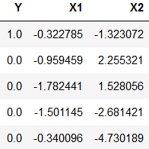
Binary classification
Categories are typically coded as numbers (e.g. 0 or 1)
Looks like a regression problem
Notes:
Explaining why someone might think linear regression is good for binary classification problems

Slide 9
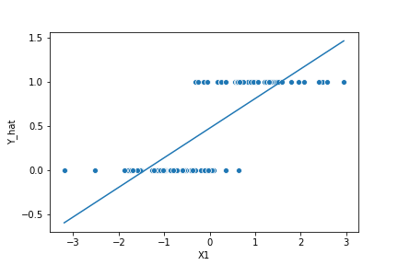
Linear regression failings
Predictions that exceed possible value range
Difficult to interpret output as probabilities of belonging to a class
Difficult to interpret the meaning of model coefficients

Slide 10
Logistic regression
To the Rescue!

Slide 11
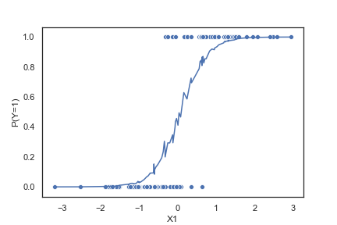
Logistic regression
Desirable Properties:
Predictions are in the range of (0, 1)
Predictions represent the probability of belonging to a class

Slide 12

Unpacking logistic regression
Logistic regression estimates the log-odds of the event that Y = 1 as a linear function of predictors (X):
$$l=ln\left(\frac{p}{1−p}\right)=β_{0}+\sum_{k=1}^{K}{β_{k}x_{k}}$$
Rearranging, we have the Pr(Y=1) as the standard logistic function:
$$p=\frac{1}{1+e^{−(β_{0}+\sum_{k=1}^{K}{β_{k}x_{k})}}}$$

Slide 13
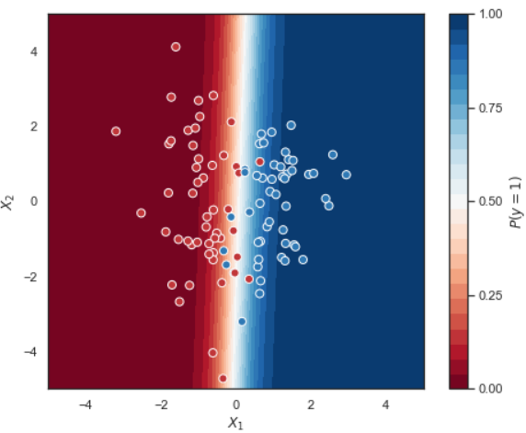
How does logistic regression classify?
Find the line that best separates the two classes!

Slide 14
Cost function
How to determine the best separating hyperplane?

Slide 15

Cost function: Binary cross entropy loss
Binary cross entropy loss:
$$J\left(β\right)=−\frac{1}{N}\sum_{i=1}^{N}{[y^{\left(i\right)}×\ln\left(p_{β}\left(X^{\left(i\right)}\right)\right)+(1−y^{\left(i\right)})×(1−\ln\left(p_{β}\left(X^{\left(i\right)}\right)\right))]}$$
where:
$$p_{β}(X^{(i)})=\frac{1}{1+e^{−(β_{0}+\sum_{k=1}^{K}{β_{k}x_{k}^{\left(i\right)}})}}$$

Slide 16

Unpacking Binary cross entropy loss
Binary cross entropy loss:
$$J\left(β\right)=−\frac{1}{N}\sum_{i=1}^{N}{[y^{\left(i\right)}×\ln\left(p_{β}\left(X^{\left(i\right)}\right)\right)+(1−y^{\left(i\right)})×(1−\ln\left(p_{β}\left(X^{\left(i\right)}\right)\right))]}$$
Depends mostly on the true label $y^{(i)}$:
When $y^{(i)}=1$, $J\left(β\right)=−\frac{1}{N}\sum_{i=1}^{N}{[y^{\left(i\right)}×\ln\left(p_{β}\left(X^{\left(i\right)}\right)\right)]}$
When $y^{(i)}=0$, $J\left(β\right)=−\frac{1}{N}\sum_{i=1}^{N}{[(1−y^{\left(i\right)})×(1−\ln\left(p_{β}\left(X^{\left(i\right)}\right)\right))]}$
The value inside the square brackets ranges from $(\ln\left(0\right),\ln\left(1\right))$
The logarithmic function is monotonically increasing

Slide 17

Counting the cost
True Label | Predict Label | P(Y=1) | ln(.) | Loss
1 | 1 | 0.7 | ln(0.7) | 0.36
1 | 1 | 0.9 | ln(0.9) | 0.11
0 | 0 | 0.3 | ln(0.7) | 0.36
0 | 0 | 0.1 | ln(0.9) | 0.11
1 | 0 | 0.3 | ln(0.3) | 1.20
1 | 0 | 0.1 | ln(0.1) | 2.30
0 | 1 | 0.7 | ln(0.3) | 1.20
0 | 1 | 0.9 | ln(0.1) | 2.30
Cost Function:
$$J\left(β\right)=−\frac{1}{N}\sum_{i=1}^{N}{[y^{\left(i\right)}×\ln\left(p_{β}\left(X^{\left(i\right)}\right)\right)+(1−y^{\left(i\right)})×(1−\ln\left(p_{β}\left(X^{\left(i\right)}\right)\right))]}$$
Rewards more confident predictions if correct; penalizes more confident predictions if wrong
Symmetric penalization of errors
Minimizing binary cross entropy loss function gets the model to predict correctly, with the right amount of confidence

Slide 18
Gradient descent
Finding the best coefficients to minimize our cost function

Slide 19
Gradient descent intuition
How can we find the lowest point in a valley while blindfolded?
Suppose we are in the region, we could, at our starting point:
Feel around with our feet for the direction where the elevation is sloping downwards the most
Head in that direction
Repeat Steps 1. and 2. until the land is no longer sloping downwards

Slide 20
Gradient descent algorithm
Randomly initialize coefficients
Compute the cost function
Compute the derivative of the cost function with regards to each coefficient
Update each coefficient in proportion to its derivative
Repeats Steps 2 – 4 until the decrease in the cost function is below a predetermined threshold or we have reached the maximum iterations

Slide 21
Gradient descent visualized
Classifier Training
Loss Function Topography

Slide 22
Evaluation Metrics

Slide 23
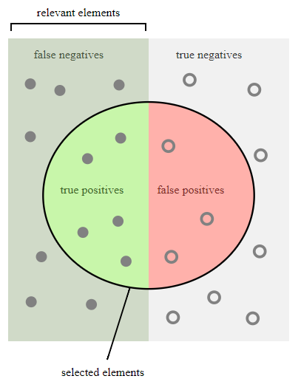
terminology
True Label | Predicted Label | Term
1 | 1 | True Positive
1 | 0 | False Negative
0 | 1 | False Positive
0 | 0 | True Negative

Slide 24
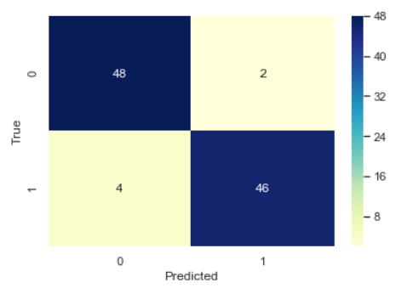
Confusion matrix
Diagonals are what the model correctly classified
Off-diagonals are what the model classified wrongly

Slide 25

accuracy
Accuracy is defined as:
$$Accuracy= \frac{TP+TN}{TP+FP+TN+FN}$$
Default metric most people use
Can be a poor metric to evaluate a classifier under certain conditions

Slide 26
99% of the training sample is of a given class, what accuracy does the model achieve if it just classifies everything as that class?
Class imbalance will skew your results!

Slide 27
Suppose 50% of a town’s residents are terrorists. The country’s security department has implemented a classifier to identify terrorists. Alleged terrorists will be killed on the spot.
With terrorist as the positive class, is it more important to have fewer false negatives or false positives?

Slide 28
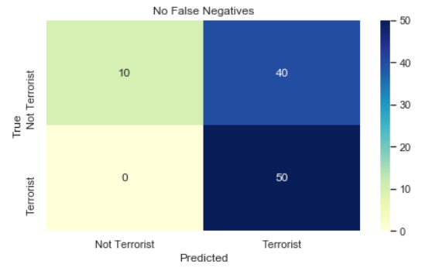
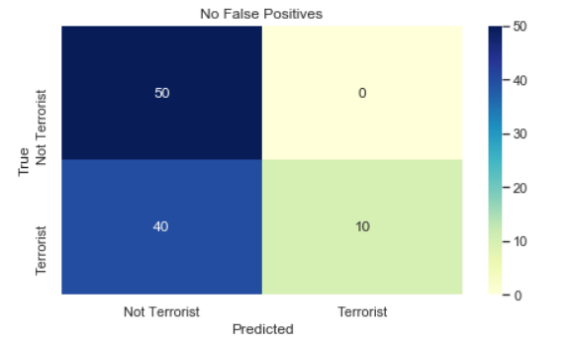
Terrorist identification
Prioritizing National Security
Prioritizing Innocent Lives

Slide 29
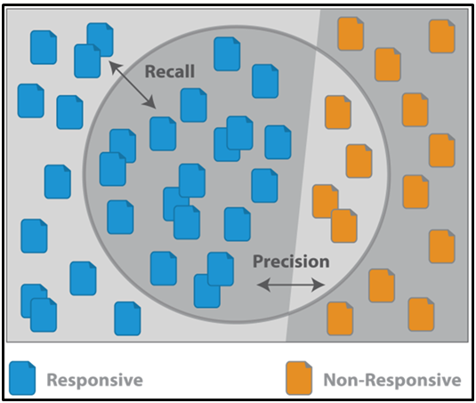

Precision and Recall
Precision:
$$\frac{TP}{TP+FP}$$
Recall:
$$\frac{TP}{TP+FN}$$
F1-Score:
$$\frac{2×Precision×Recall}{Precision+Recall}$$

Slide 30
Evaluation metrics
What is the precision, recall and F1-Score?
What is the accuracy score?

Slide 31
Questions?

Slide 32
Appendix

Slide 33
Derivation of probability from log-odds

Slide 34

Derivation of probability from log-odds
$$\ln\left(\frac{p}{1−p}\right)=β_{0}+\sum_{k=1}^{K}{β_{k}x_{k}} \\ exp⁡(\ln\left(\frac{p}{1−p}\right)=exp⁡(β_{0}+\sum_{k=1}^{K}{β_{k}x_{k}}) \\ \frac{p}{1−p}=\exp\left(β_{0}+\sum_{k=1}^{K}{β_{k}x_{k}}\right) \\ p=\left(1−p\right)×\exp\left(β_{0}+\sum_{k=1}^{K}{β_{k}x_{k}}\right)$$
Cont’d next slide

Slide 35

Derivation of probability from log-odds
$$p=\exp\left(β_{0}+\sum_{k=1}^{K}{β_{k}x_{k}}\right)−p×\exp\left(β_{0}+\sum_{k=1}^{K}{β_{k}x_{k}}\right) \\ p+p×\exp\left(β_{0}+\sum_{k=1}^{K}{β_{k}x_{k}}\right)=\exp\left(β_{0}+\sum_{k=1}^{K}{β_{k}x_{k}}\right) \\ p=\frac{\exp\left(β_{0}+\sum_{k=1}^{K}{β_{k}x_{k}}\right)}{1+\exp\left(β_{0}+\sum_{k=1}^{K}{β_{k}x_{k}}\right)}÷\frac{\exp\left(β_{0}+\sum_{k=1}^{K}{β_{k}x_{k}}\right)}{\exp\left(β_{0}+\sum_{k=1}^{K}{β_{k}x_{k}}\right)} \\ p=\frac{1}{1+\exp\left({−(β}_{0}+\sum_{k=1}^{K}{β_{k}x_{k}}\right))}$$

Slide 36
Derivation of gradient descent derivatives

Slide 37

Derivation of gradient descent derivatives
Let:
$$z=β_{0}+\sum_{k=1}^{K}{β_{k}x_{k}} \\ p\left(z\right)=\frac{1}{1+e^{−z}} \\ p^{′}\left(z\right)=p\left(z\right)×\left(1−p\left(z\right)\right) \\ \frac{∂z}{∂β_{k}}=x_{k} \\ \frac{∂ln⁡(q)}{∂q}=\frac{1}{q}$$

Slide 38

Derivation of gradient descent derivatives
The term in the square bracket of the cost function is:
$$y×\ln\left(p\right)+(1−y)×ln⁡(1−p)$$
Its derivative is:
$$y×\frac{1}{p}×p^{′}+\left(1−y\right)×\frac{1}{1−p}×\left(−p^{′}\right) \\ =\left(\frac{y}{p}−\frac{1−y}{1−p}\right)×p^{′} \\ =\frac{y\left(1−p\right)−p(1−y)}{p(1−p)}p^{′} \\ =\frac{y−yp−p+yp}{1(1−p)}p^{′} \\ =\frac{y−p}{p\left(1−p\right)}p\left(1−p\right)x \\ =(y−p)×x$$

Slide 39

Derivation of gradient descent derivatives
Finally, the derivation we are interested in is:
$$\frac{∂J(β)}{∂β}=−\frac{1}{N}\sum_{i=1}^{N}{(y^{\left(i\right)}−p_{β}(x^{(i)}))×x_{k}^{(i)}}$$
Using this derivative, we can update each $β_{k}$ at time step $(t+1)$ as follows:
$$β_{k,t+1}=β_{k,t}−α×\frac{∂J(β)}{∂β}$$

